Slide 1




NXTWAVE
WELCOME
HTTPS://WWW.CCBP.IN/

Slide 2
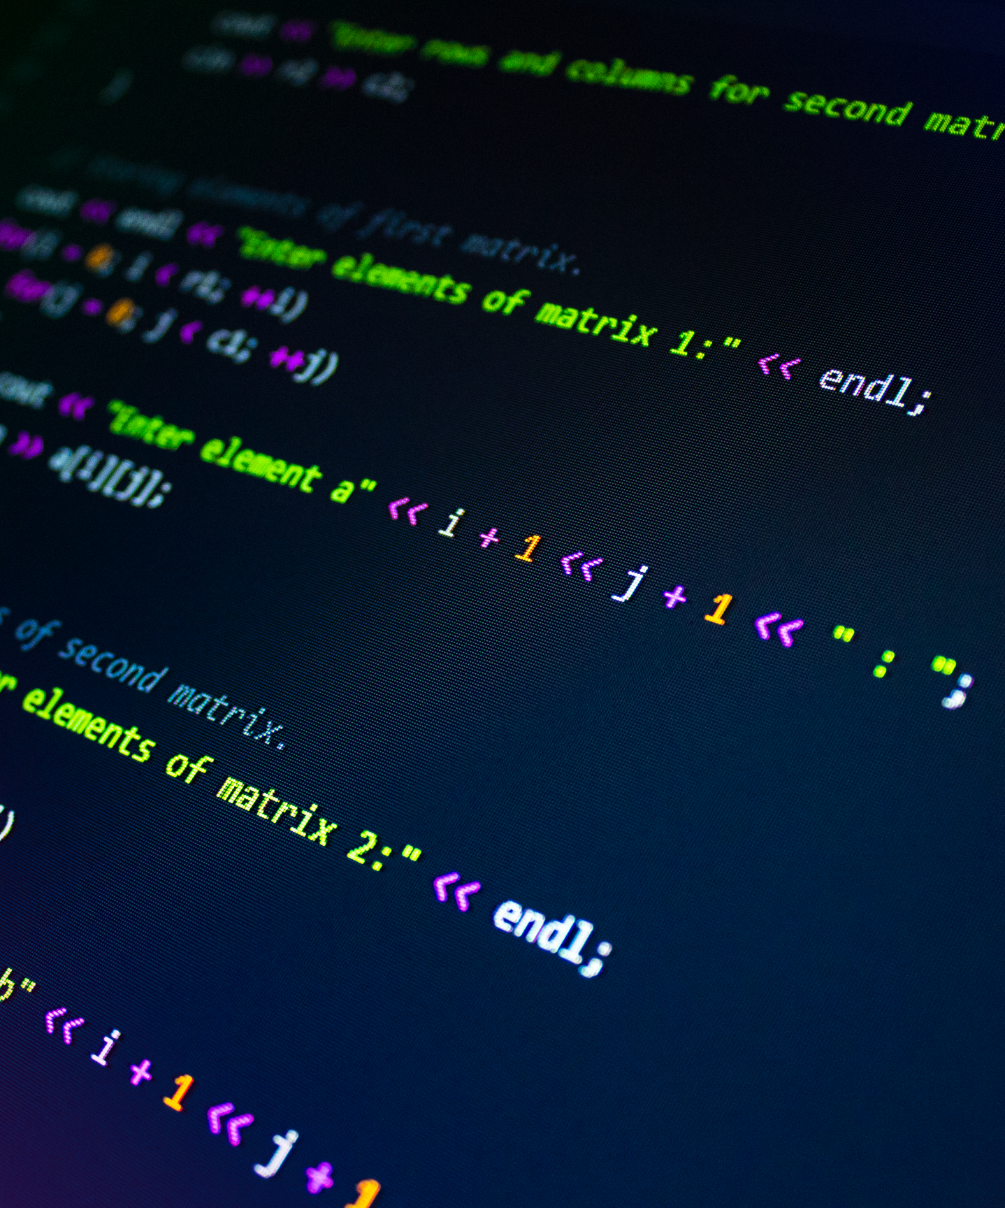
NXTWAVE
INTRODUCTION TO PROGRAMMING

Slide 3

NXTWAVE
WHAT DO YOU KNOW ABOUT CODING?
Programming means writing the instructions. These instructions are
called as Code. Popular Programming Languages are Python, Java, C, C++, C#, Ruby, Scala, Kotlin, R, JavaScript, Dart

Slide 4




NXTWAVE
APPLICATIONS
01
02
AI/Machine Language
Big Data
03
04
Smart Devices/ IOT
Game Development

Slide 5
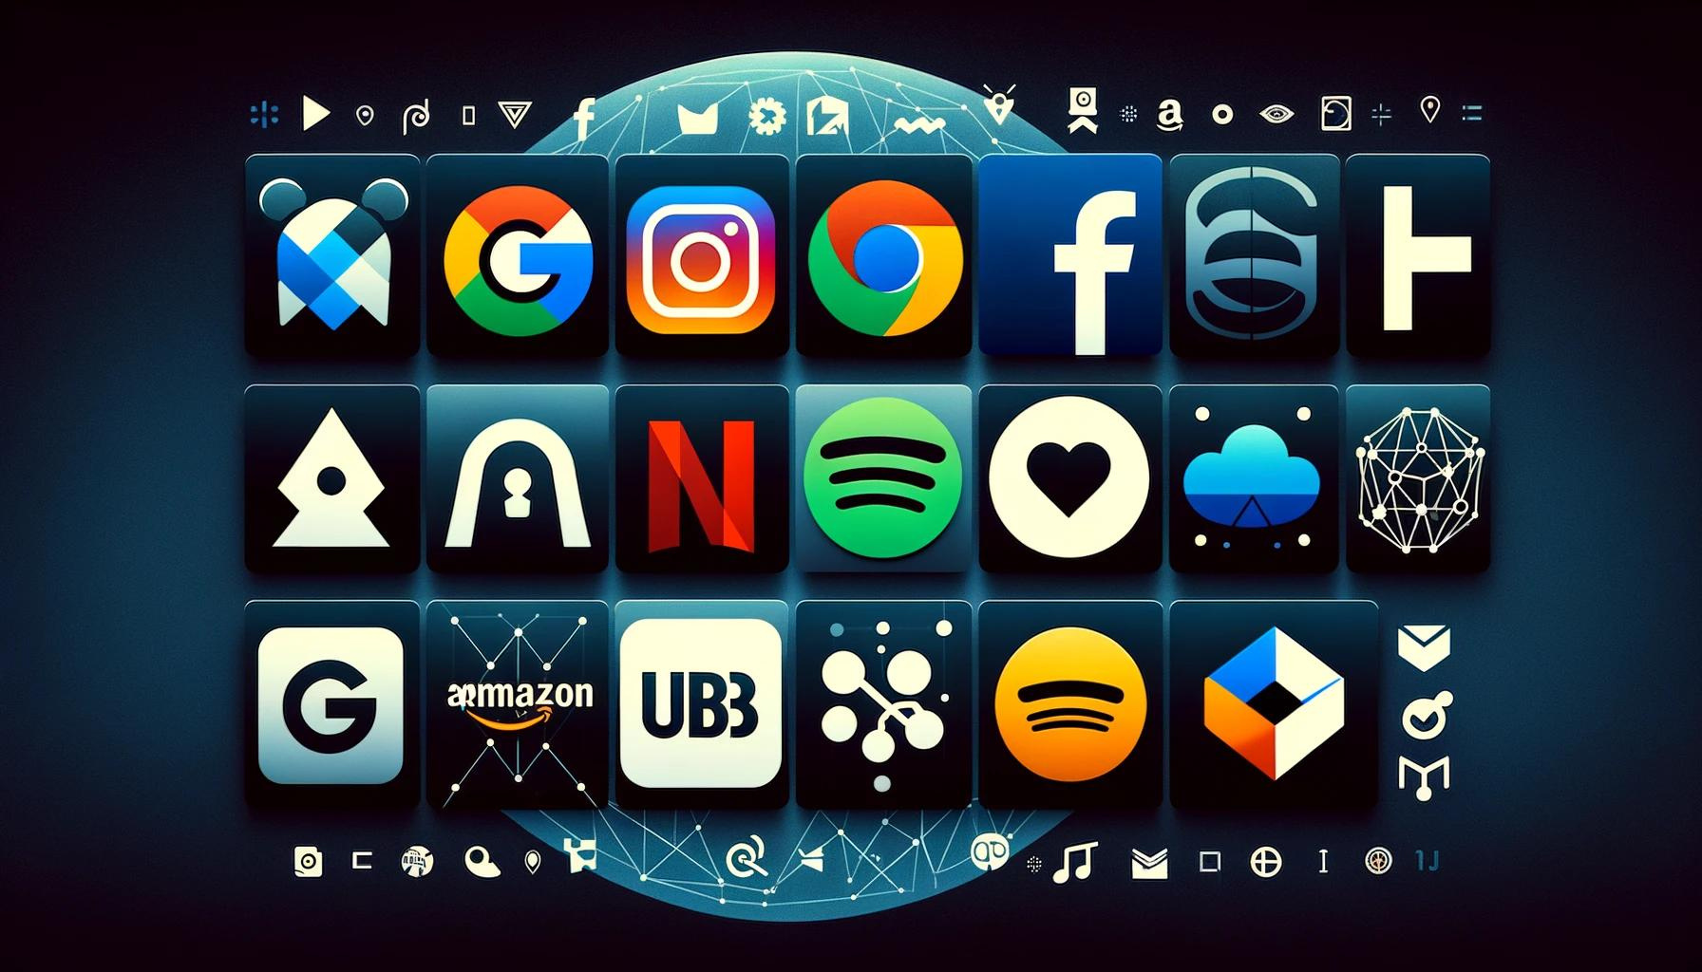
NXTWAVE
POPULAR IN TOP COMPANIES
Major Tech Companies use Python extensively

Slide 6




NXTWAVE
Salaries
$ 140k (US) - ₹ 1,02,54,020 (IN) | - $ 138k (US) - ₹ 1,01,07,534 (IN) | $ 150k (US) - ₹ 1,09,86,450 (IN)
Google | Amazon | Microsoft

Slide 7
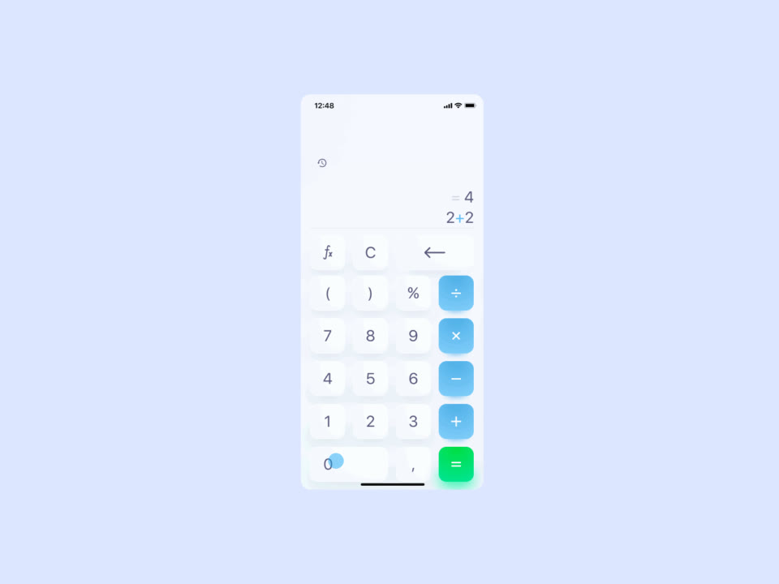
NXTWAVE
Arithmetic Operations
A simple Program would be a calculator App.
It can do simple Arithmetic operations like addition, subtraction multiplication, division

Slide 8
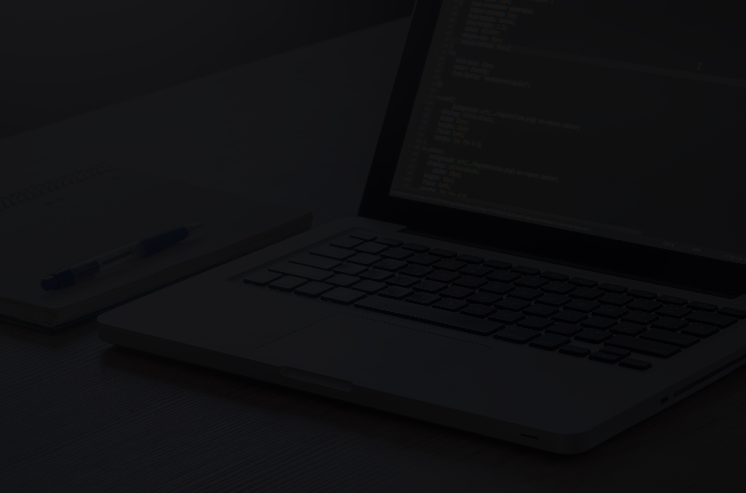
NXTWAVE
THANK YOU
HTTPS://WWW.CCBP.IN/

